Slide 1

Session Name:
Types of Optimization Problems
Delivered By:
Mr. Ritwik Sinha

Slide 2

Optimization
Need of Optimization problems:
Key benefits of utilizing Optimization problems are:-
Efficient Resource Utilization : Supply Chain Management (logistics, inventory, transportation)
Cost Reduction and Profit Maximization : Pricing Strategies, Production Schedules, Advertising budgets
Machine Learning : Minimize Loss Function (MSE, Cross Entropy)
Robotics and Automation : Path Optimization
Energy Efficiency and Sustainability : Renewable energy systems to maximize power output

Slide 3

Learning Objectives
By the end of this session, you will be able to:
Define the need of using Optimization problems.
Define and understand Warehouse problems.
Understand the principles of Assignment problems.
Define the Knapsack probem.

Slide 4
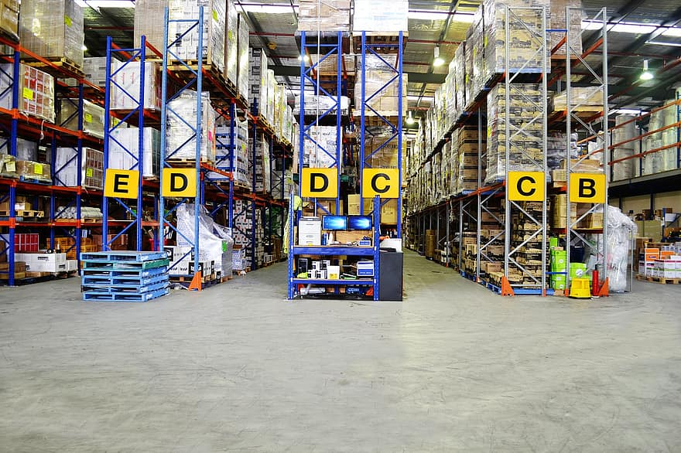
Warehouse Problem
What is Warehouse Optimization:- It is an efficient operation of warehouse of all sizes.
Goal:- Disciplined process, Automation, Save time – space – resources, Reducing Errors, Improving flexibility – communication – management – customer satisfaction
Challenges:- Errors, Inefficiency, Lack of Transparency

Slide 5
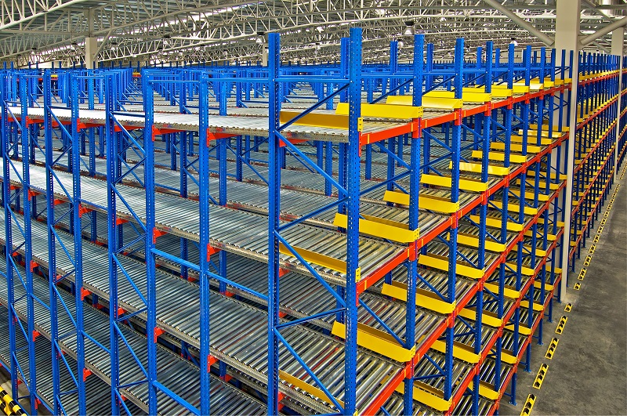
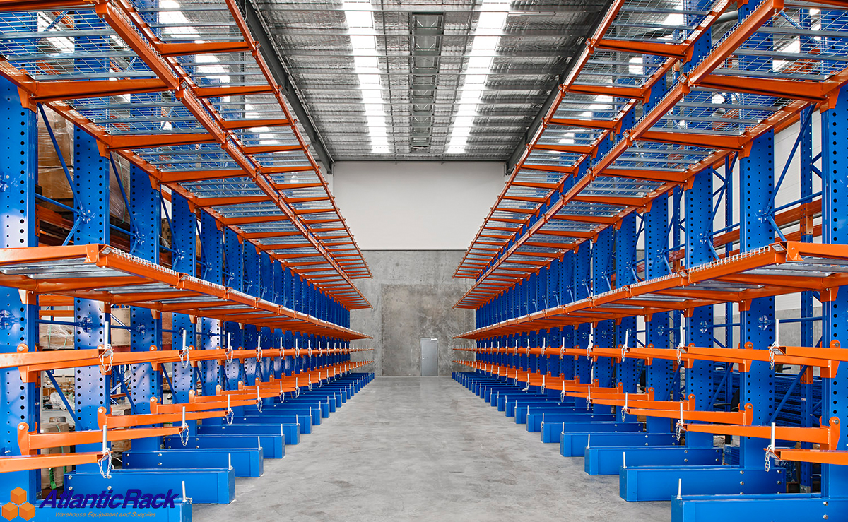
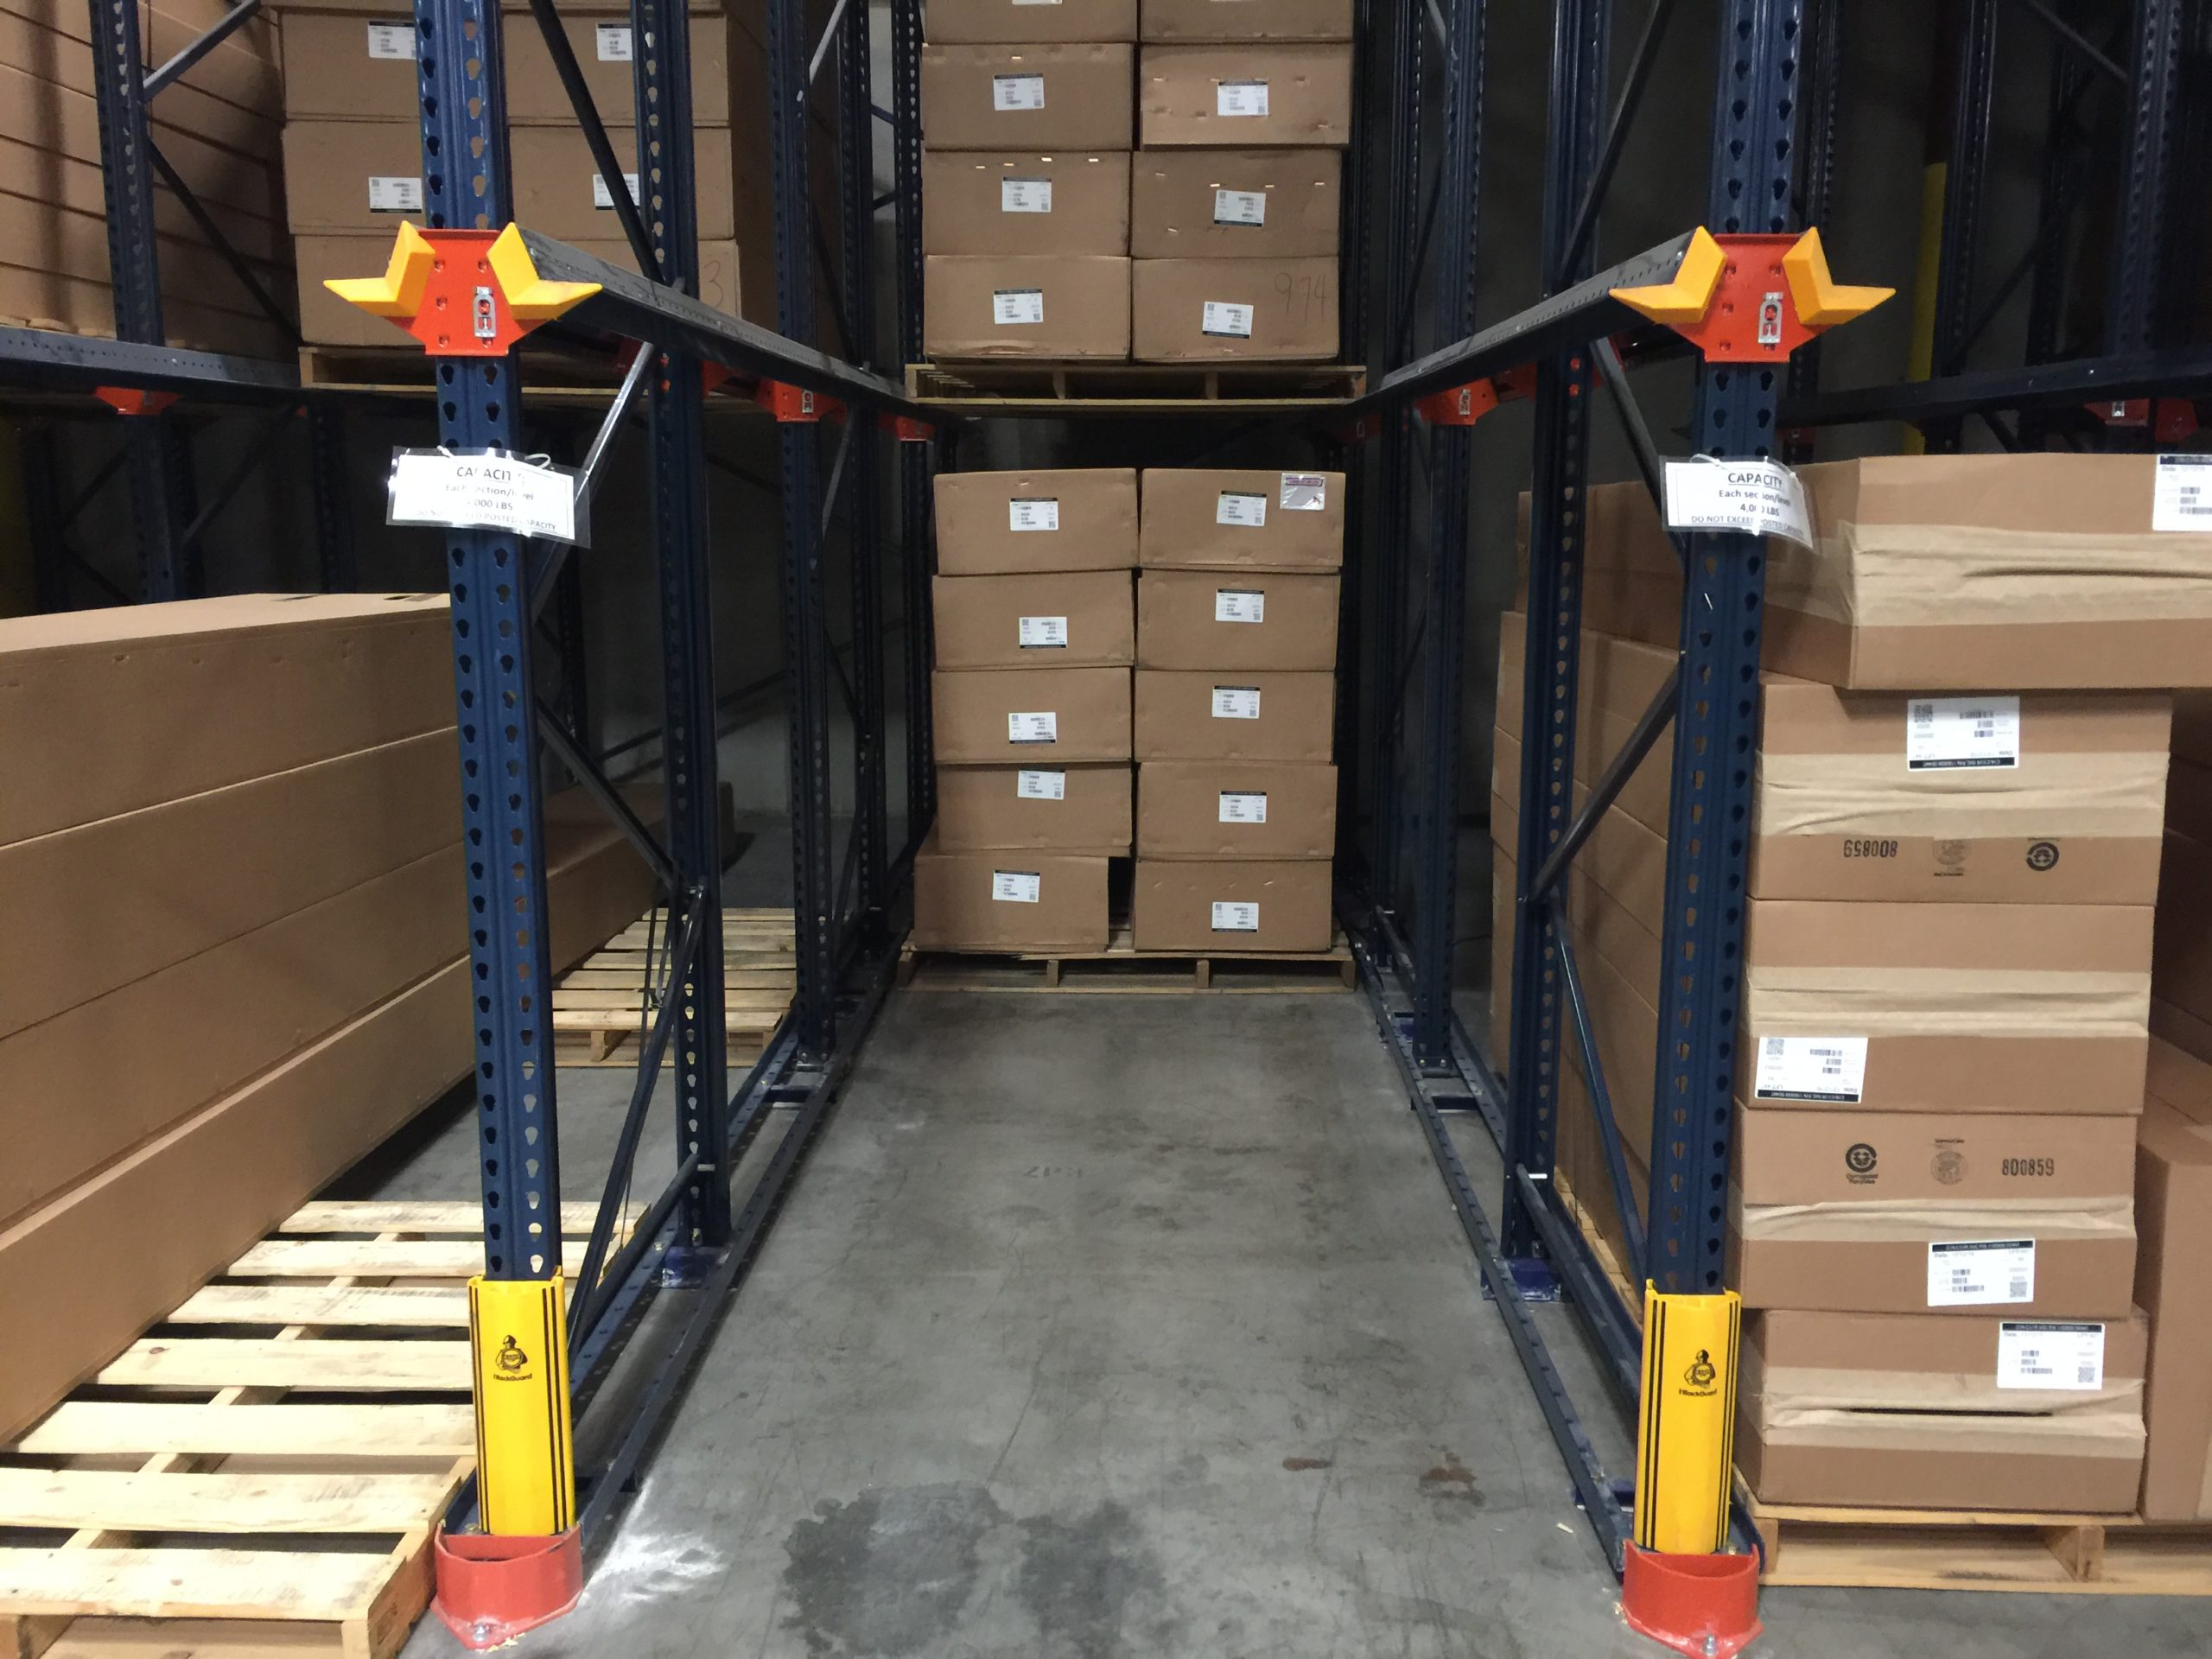
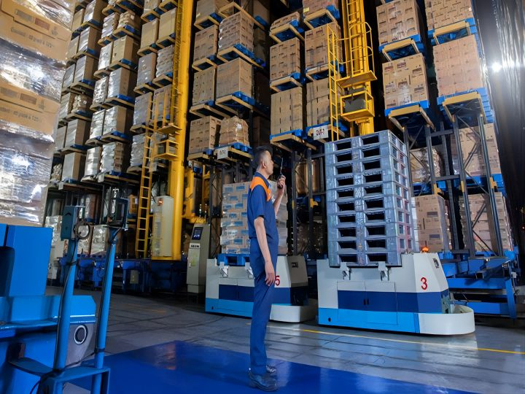
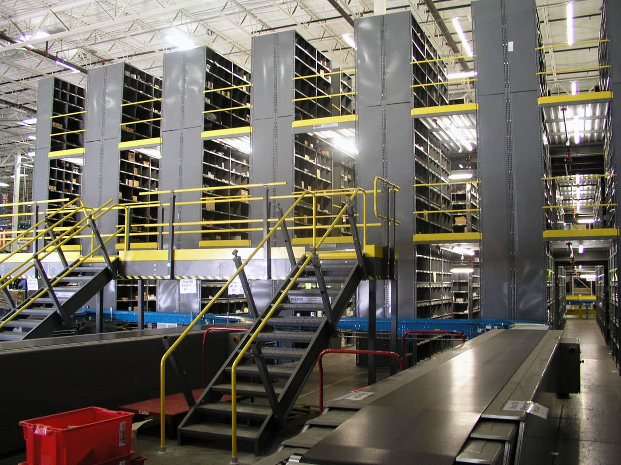
Warehouse Optimization Solution
Space Optimization : The core principle is to utilize every inch of available space. Businesses can imply racking systems, such as pallet racking, cantilever, drive-in racking, high rise shelving, mezzanine levels
Labor Optimization : Enhancing workforce productivity without compromising employee welfare. Hiring well qualified employees, regular training programs, safety protocols drills, and effective shift planning.
Inventory Optimization : Adherence to FIFO methods, regular stocks audits, emphasizing dynamic allocation to sales channels to meets real time demand, and maximize profit.
Storage Optimization : Strategic placement of stocks, rotation of stocks.
Technological Optimization : Real time product tracking, amplifying visibility, automated conveyors, robots.
Process Optimization : Fine-tuning of all internal processes to ensure peak efficiency. Strategies like cross-docking, where incoming goods are directly transferred to outbound gates, can lead to reduced storage durations and quicker deliveries.

Slide 6
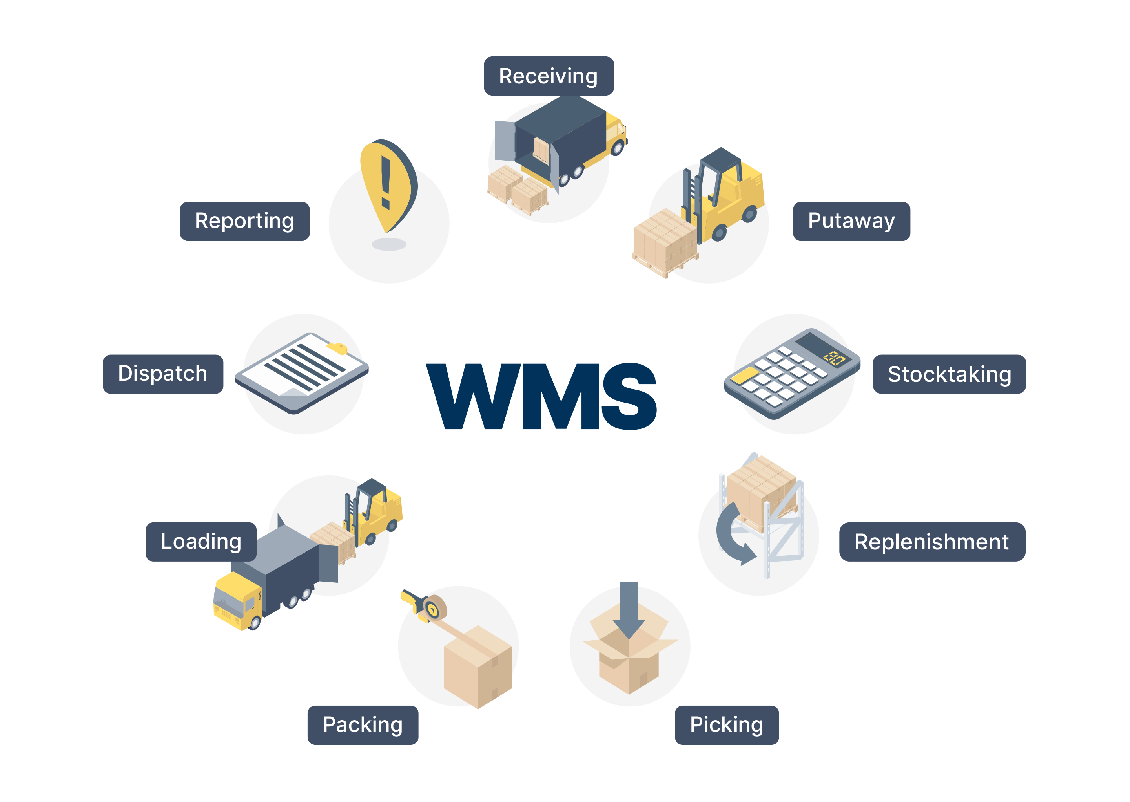
Optimize your Warehouse
12 Strategies to Optimize Warehouse:-
Warehouse Management System
Data Analytics for Demand Forecasting
Warehouse Automation and Robotics
Regular Training and Development
Smart Shelving Systems
Lean Inventory Practices
Warehouse Layout Design
Green Practices
Safety Protocols
IoT (Internet of Things) Devices
Regular Audit Systems
Product Velocity Knowledge – ABC analysis: classifying inventory into 'A' items (high-value products with low frequency), 'B' items (moderate value and frequency), and 'C' items (low value with high frequency)

Slide 7
Assignment Problems
What is Assignment Optimization:- It is an optimization problem where objective is to assign agents to different tasks so as to minimize total cost, and maximize profit
Goal:- Discover an assignment, search for the maximum flow of minimum cost, solving transportation problem
Challenges:- Close Deadlines, Lots of things to do, Credible information, Critical Thinking and Problem Solving, Presentation Skills

Slide 8
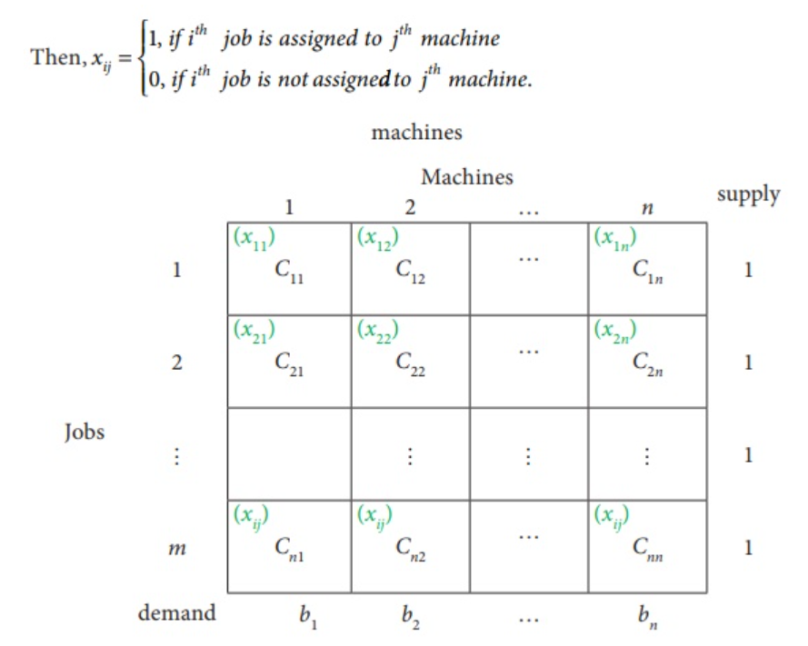
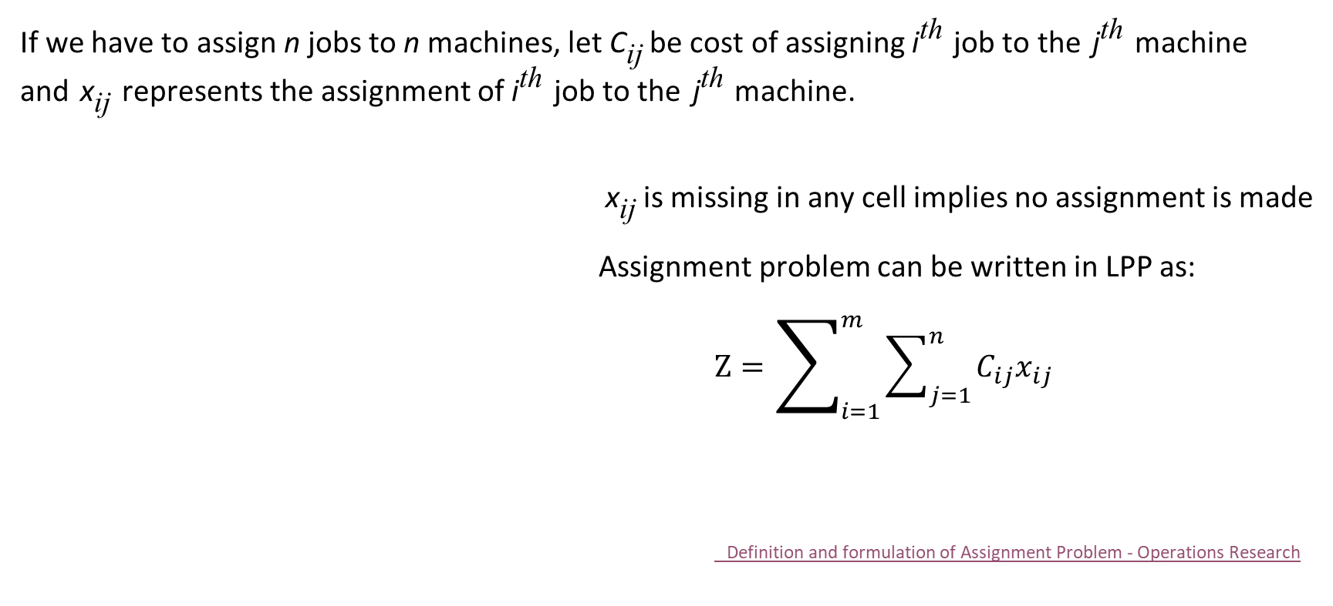
Defining Assignment Problem
If we have to assign n jobs to n machines, let C_{ij} be cost of assigning i^{th} job to the j^{th} machine and x_{ij} represents the assignment of i^{th} job to the j^{th} machine.
x_{ij} is missing in any cell implies no assignment is made
Assignment problem can be written in LPP as:
$Z=\sum_{i=1}^{m}{\sum_{j=1}^{n}{C_{ij}x_{ij}}}$
Definition and formulation of Assignment Problem - Operations Research

Slide 9
Knapsack Problems
What is Knapsack Optimization:- Given N items, every item having profit associated with it, and a bag with capacity of W (weight which a bag can hold at max)
Goal:- Put the items into the bag such that sum of profits associated with them is maximum
Challenges:- We can either put an item completely into the bag or cannot put it at all [A part of an item can not be added into the bag]
Example:-
Input : N = 3, W = 4, profit [] = {1, 2, 3}, weight [] = {4, 5, 1}
Output : 3
Explanation : There are two items which have weight less than or equal to 4. If we select the item with weight 4, the possible profit is 1. And if we select the item with weight 1, the possible profit is 3. So the maximum possible profit is 3. Note that we cannot put both the items with weight 4 and 1 together as the capacity of the bag is 4.

Slide 10
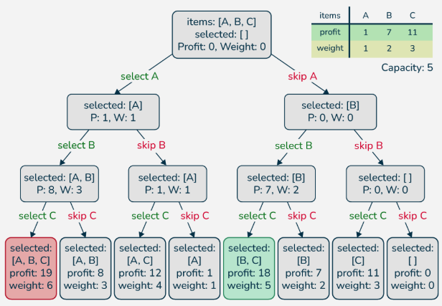
Knapsack Problems

Slide 11
Academic Poll
The Warehouse Location Problem aims to:
Minimize transportation and storage costs
Maximize the number of warehouses
Ensure every product has a dedicated warehouse
Store equal quantities in all warehouses
Which algorithm is commonly used to solve the Assignment Problem efficiently?
Kruskal’s Algorithm
Dijkstra’s Algorithm
Hungarian Algorithm
A* Algorithm

Slide 12
Academic Poll
The Warehouse Location Problem aims to:
Minimize transportation and storage costs
Maximize the number of warehouses
Ensure every product has a dedicated warehouse
Store equal quantities in all warehouses
Which algorithm is commonly used to solve the Assignment Problem efficiently?
Kruskal’s Algorithm
Dijkstra’s Algorithm
Hungarian Algorithm
A* Algorithm

Slide 13
Academic Poll
Which of the following is not a type of Knapsack Problem?
0/1 Knapsack Problem
Fractional Knapsack Problem
Multiple Knapsack Problem
Greedy Knapsack Problem
What is the time complexity of the 0/1 Knapsack Problem using Dynamic Programming?
𝑂(𝑛)O(n)
𝑂(2𝑛)O(2 n )
𝑂(𝑛𝑊)O(nW)
𝑂(𝑛log⁡𝑛)O(nlogn)

Slide 14
Academic Poll
Which of the following is not a type of Knapsack Problem?
0/1 Knapsack Problem
Fractional Knapsack Problem
Multiple Knapsack Problem
Greedy Knapsack Problem
What is the time complexity of the 0/1 Knapsack Problem using Dynamic Programming?
𝑂(𝑛)O(n)
𝑂(2𝑛)O(2 n )
𝑂(𝑛𝑊)O(nW)
𝑂(𝑛log⁡𝑛)O(nlogn)

Slide 15
Session Summary
In this session, we have discussed about:
Introduction to Optimization Problems
Warehouse Problems
Assignment Problems
Knapsack Problems

Slide 16

Happy Learning!

